Slide 1


Library Management System
A Major Project by:
ANNAPU ANUSHA 110520539001
PARAMA SHIVA 110520539011
PADURLA PARTHY SURYA VAMSHI 110520539018
S RUSHENDRA 110520539020

Slide 2
Library Management System
This project presents a Library Management System (LMS) designed to help librarians keep track of books, members, and loan transactions. The system is developed using Python programming language, with SQL database to store the data, and Tkinter library, the fastest and easiest ways to build GUI applications. Moreover, Tkinter is cross-platform, hence the same code works on macOS, Windows and Linux. The LMS allows librarians to add, view, update and delete books. Along with these it maintains the records of books issued to students with issued time and returned time phone number and address of student. LMS is user-friendly, easy to use, and provides an efficient way to manage a library's operations. The system is tested and evaluated to ensure its functionality and performance, and the results indicate that it is a reliable and efficient solution for library management.

Slide 3
ROLE | NAME | RESPONSIBILITIES
GUI developer and code debugging | S RUSHENDRA | Creating windows Entry boxes, Message boxes Treeview
Buttons, functionalities and Background Image | ANNAPU ANUSHA | Creating buttons Button functionalities Background image
Database Connection and operations | KAMBALA PARAMA SHIVA | Connecting and closing database CRUD operations
Testing, date time entry and app integration | PADURLA PARTHY SURYA VAMSHI | Testing the system Current time operation Creating the application

Slide 4
The project objectives are:
To eliminate the paperwork in library.
To record every transaction in computerized system so that problem such as file missing won’t happen again.
To design a user-friendly Graphical User Interface (GUI) which suit the users.
To complete the system according to project schedule.

Slide 5
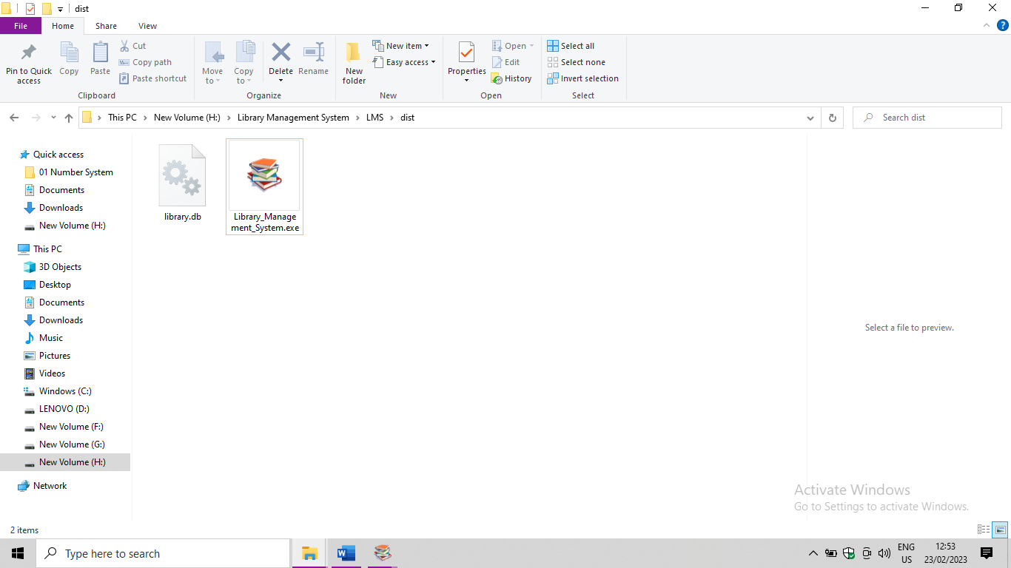
USER INTERFACE
To open Library Management System first you need to open “Library_Management_System.exe” file.
PYINSTALLER : PyInstaller is a Python library used for converting a Python script into a standalone executable program. It is often used to package Python applications into an easy-to-distribute format, which can be executed without the need for a Python interpreter or other dependencies.
You can see the following buttons in the user interface.
Add Books
View Books
Update Books
Issue Books
Return Books
Delete books
Quit

Slide 6
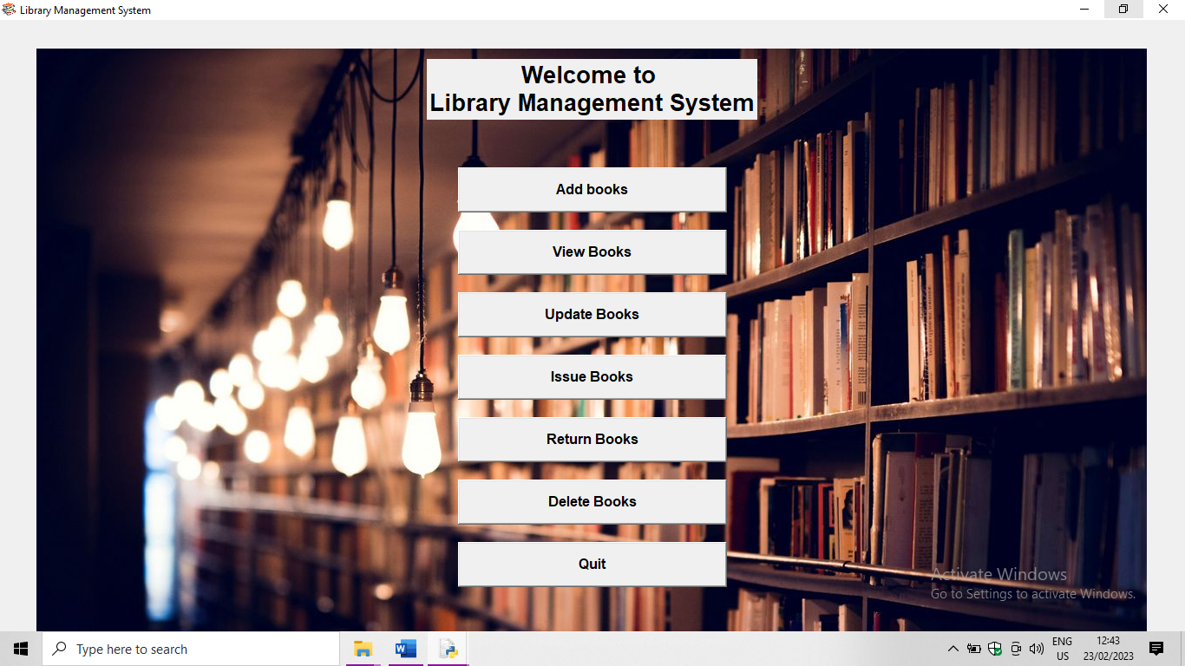

Slide 7
SQLITE3 : SQLite3 is a lightweight, self-contained relational database management system that is implemented as a library in the Python programming language. It provides a simple, fast, and reliable way to store and retrieve data in a structured manner.
To use SQLite3 in Python, you must first import the sqlite3 module. Once imported, you can create a connection to a SQLite database by calling the connect() function, passing in the name of the database file as an argument. If the database file does not exist, SQLite will create it for you automatically.
Once you have a connection to the database, you can execute SQL commands using a cursor object. The cursor is used to execute SQL commands and retrieve results. To execute a SQL command, you call the execute() method on the cursor object and pass in the SQL statement as a string.

Slide 8

To insert data into the table, you can use the execute() method with an INSERT statement.
To retrieve data from the table, you can use the SELECT statement.
You can also use other SQL commands such as UPDATE and DELETE to modify data in the table.
Once you have finished working with the database, it is important to close the connection to the database using the close() method.
In summary, SQLite3 is a powerful and easy-to-use database management system that is built into Python. It provides a simple way to store and retrieve data in a structured manner and supports a wide range of SQL commands. SQLite3 is widely used in a variety of Python applications, from small desktop applications to large-scale web applications.

Slide 9
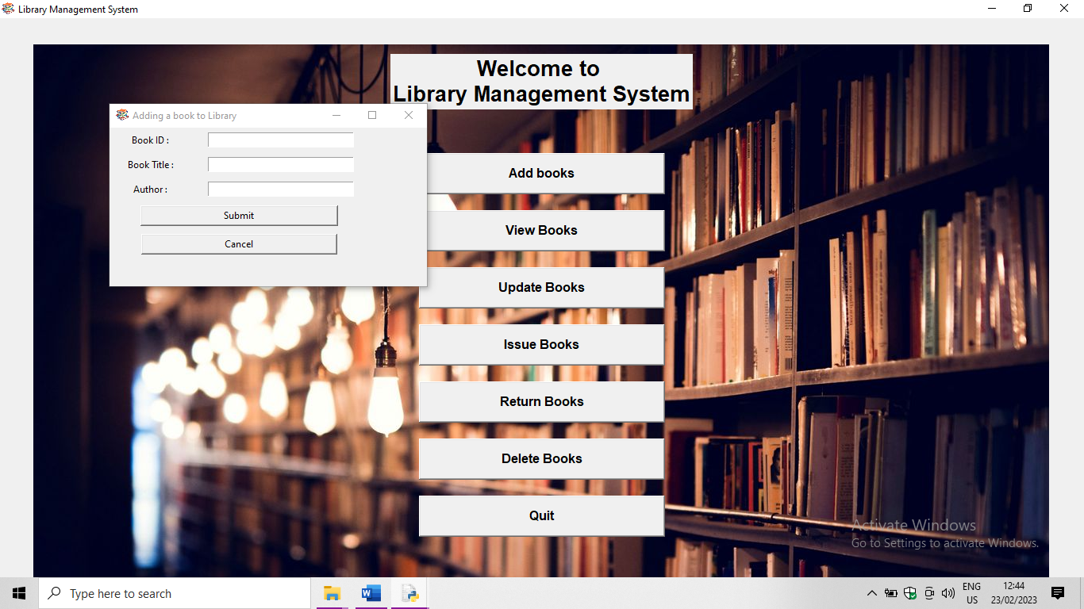
Add Books :When “Add Books” button is clicked new top window name “Adding a book to library” pops up and asks the following details.
Book ID (ISBN No. of the book)
Book Title
Author

Slide 10
View Books :
When “View Books” button is clicked new top window named “Viewing books in library” pops up and shows the details of the books such as
serial number (This should be remembered by the user if he/she wants to make changes to the book details or delete them)
Book ID
Title and
Author

Slide 11
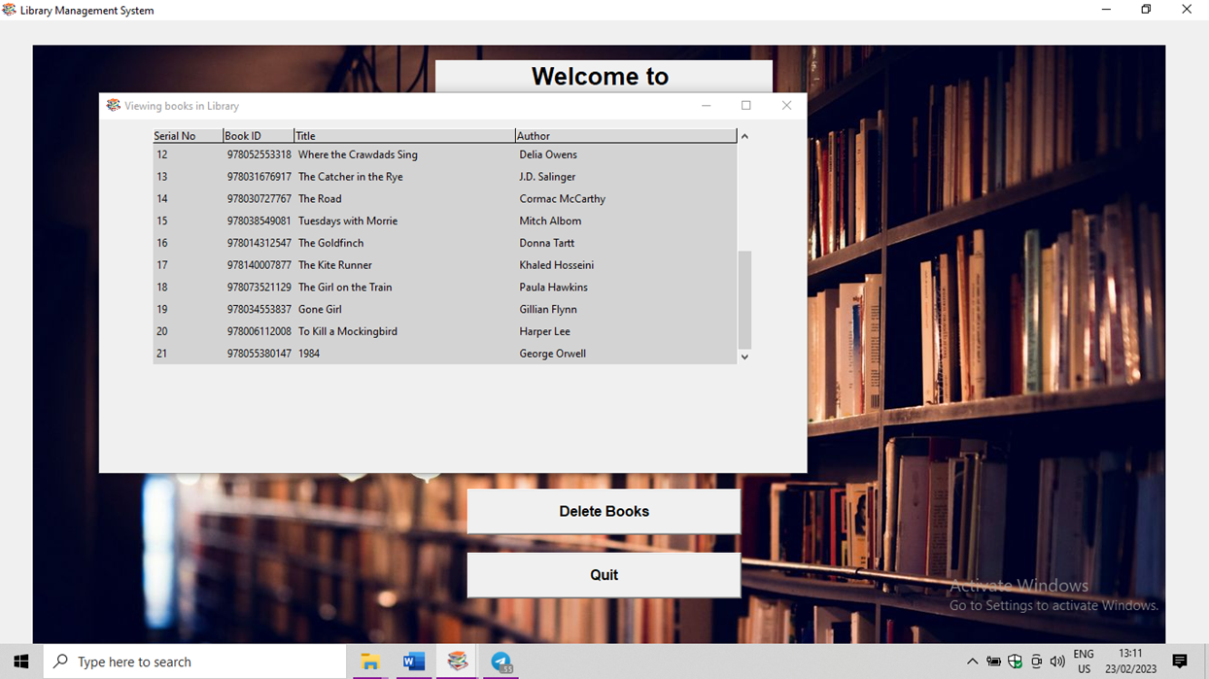

Slide 12
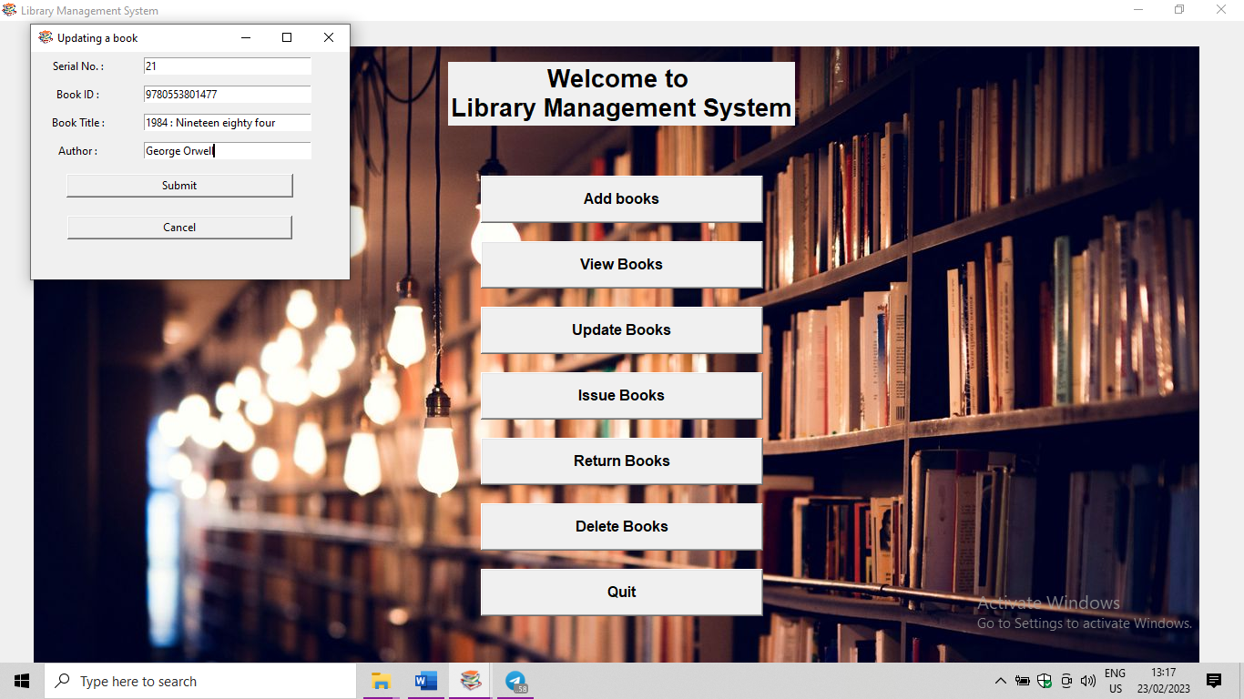
Update Books :
When “Update Books” button is clicked new top window named “Updating a book” pops up and asks for
Serial No. (For which he/she wants to update the details)
Book ID
Book Title and
Author

Slide 13
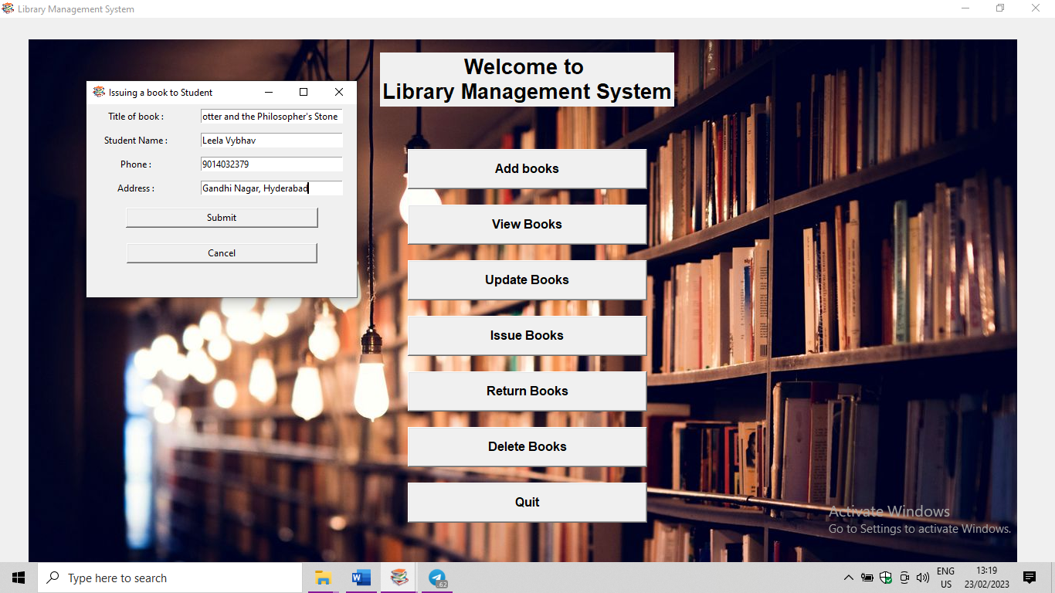
Issue Books :
When “Issue Books” button is clicked a new top-level window named “Issuing book to student” pops up and ask user to enter the following details.
Title of book
Student Name
Phone and
Address

Slide 14
Return Books:
When “Return Books” button is clicked a new top-level window named “Returning book to library” pops up and shows all the issued books with Serial No., Title of the book, Student Name, Issued Date, Return Date, Phone and Address with return date as “None” if book is not returned to library to return book select which book and which student is returning the book the serial number of that record will be shown in the entry box below under “Selected Record & Commands” tab. When “Return” button is clicked the returned date and time gets updated.
If he/she wants to delete all the records from the database “Delete All Records” button should be clicked. A message box is shown “Are you sure?” showing the message as shown in below. If user confirms by clicking “Yes” all the records gets deleted if not operation gets aborted.

Slide 15
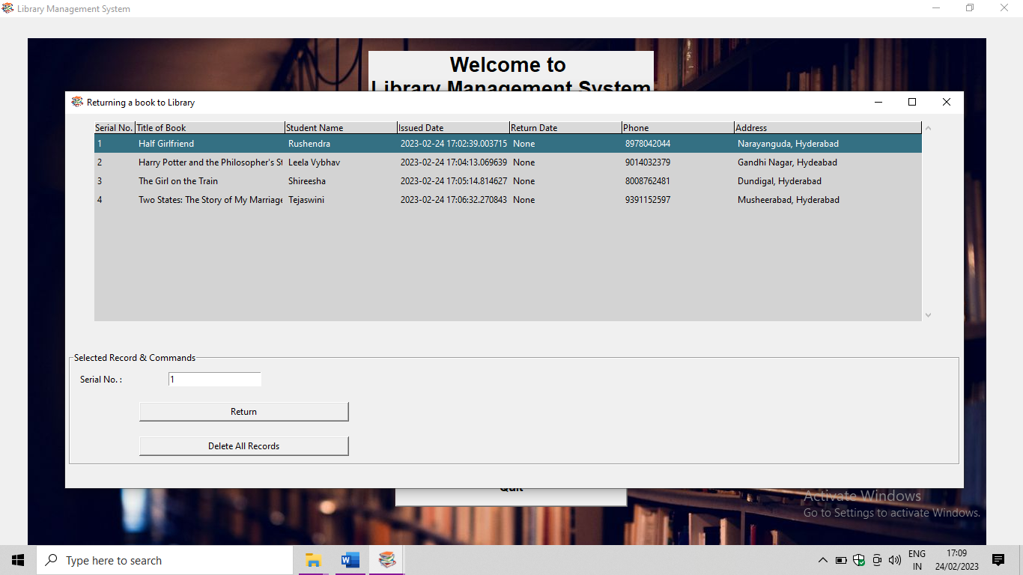

Slide 16
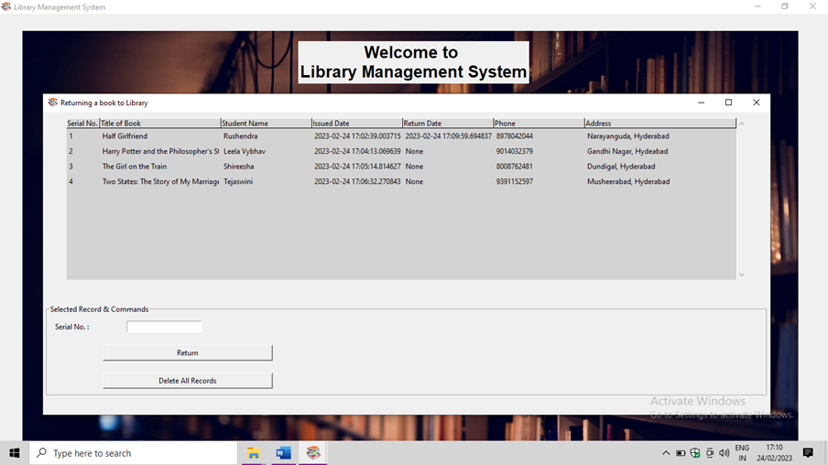

Slide 17
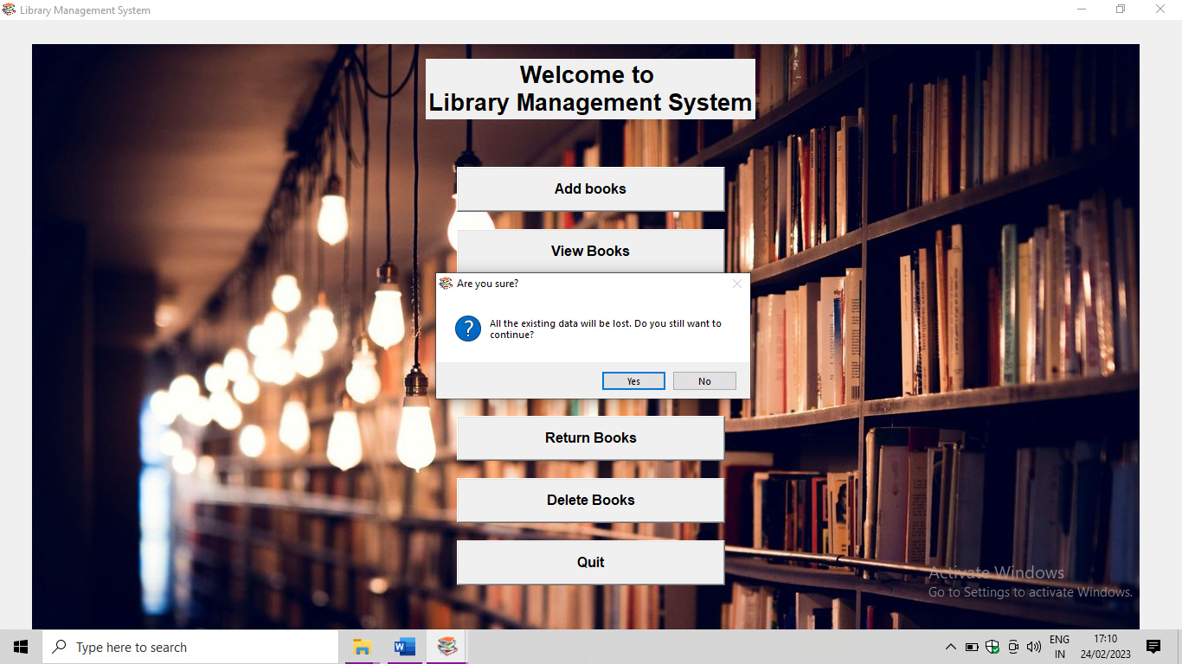

Slide 18
Delete Books:
When “Delete Books” button is clicked a new top-level window named “Deleting book from library” pops up and asks for the Serial No. as shown.
when serial number is given and “Delete” button is clicked the book gets deleted and the entry box will be cleared. If “Cancel” button is clicked the entry box will be cleared and the operation gets aborted.
If he/she wants to delete all records from library “Delete All Records” button is clicked a message box “Are you sure?” appears and If it’s confirmed with “Yes” button all the books in the library gets deleted. If not “No” button is clicked the operation gets aborted.

Slide 19
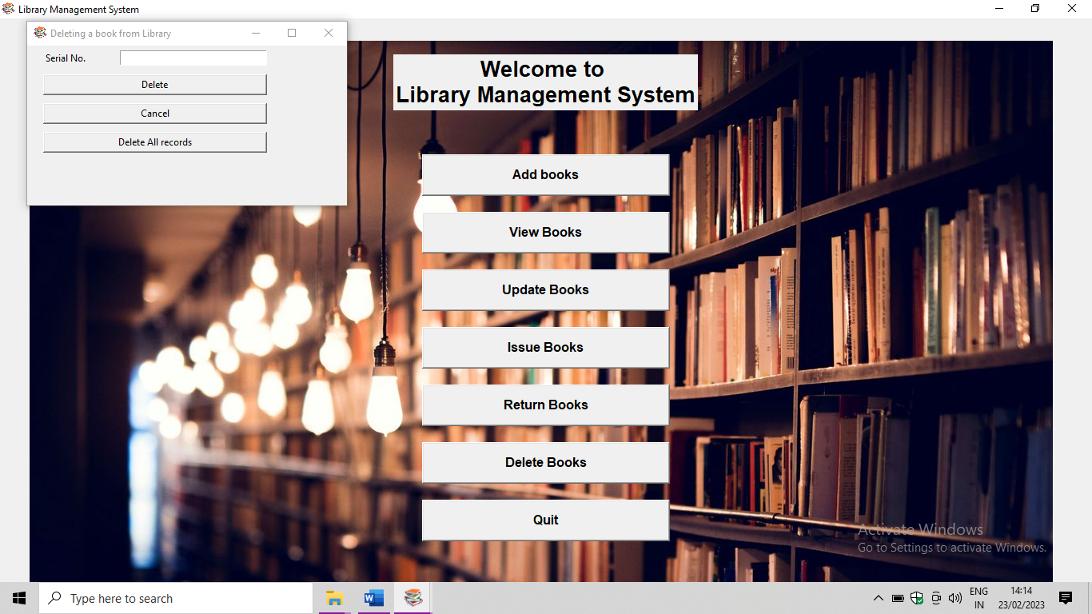

Slide 20


Slide 21
Thank you

